Slide 1
Anglican Board of Mission
ABM and the Amity Foundation: Community Development in China
Isabel Robinson, 17th August 2013

Slide 2
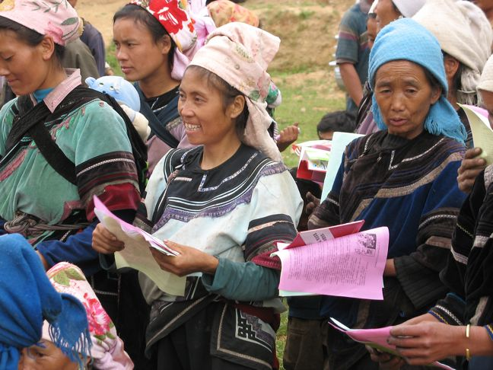
ABM and the Amity Foundation: Community Development in China
The Past
The Present
The Future
The Challenges
The Way Forward

Slide 3
The Past
ABM officially began a partnership with The Amity Foundation in 2009, at the suggestion of Act for Peace
Project funding for 3 year Ethnic Women’s Health Project in Yunnan Province began in 2010

Slide 4
Board of Directors
Executive Staff Meeting
Amity Printing Co., Ltd
HK Office
Research & Dev. Center
Social Service Center
Project Management Center
Supporting & Admin. Center
Education & International Exchange
Publicity & Resource Development
NGO Development Center
Amity Bakery
Amity Home of Blessings
Amity Children Development Center
Community Development & environ. protection
Social welfare
Education and Orphan fostering
Disaster relief
Public Health & HIV AIDS Prevention
Church & Social Service
Admin. support
HR development
Planning & accounting

Slide 5
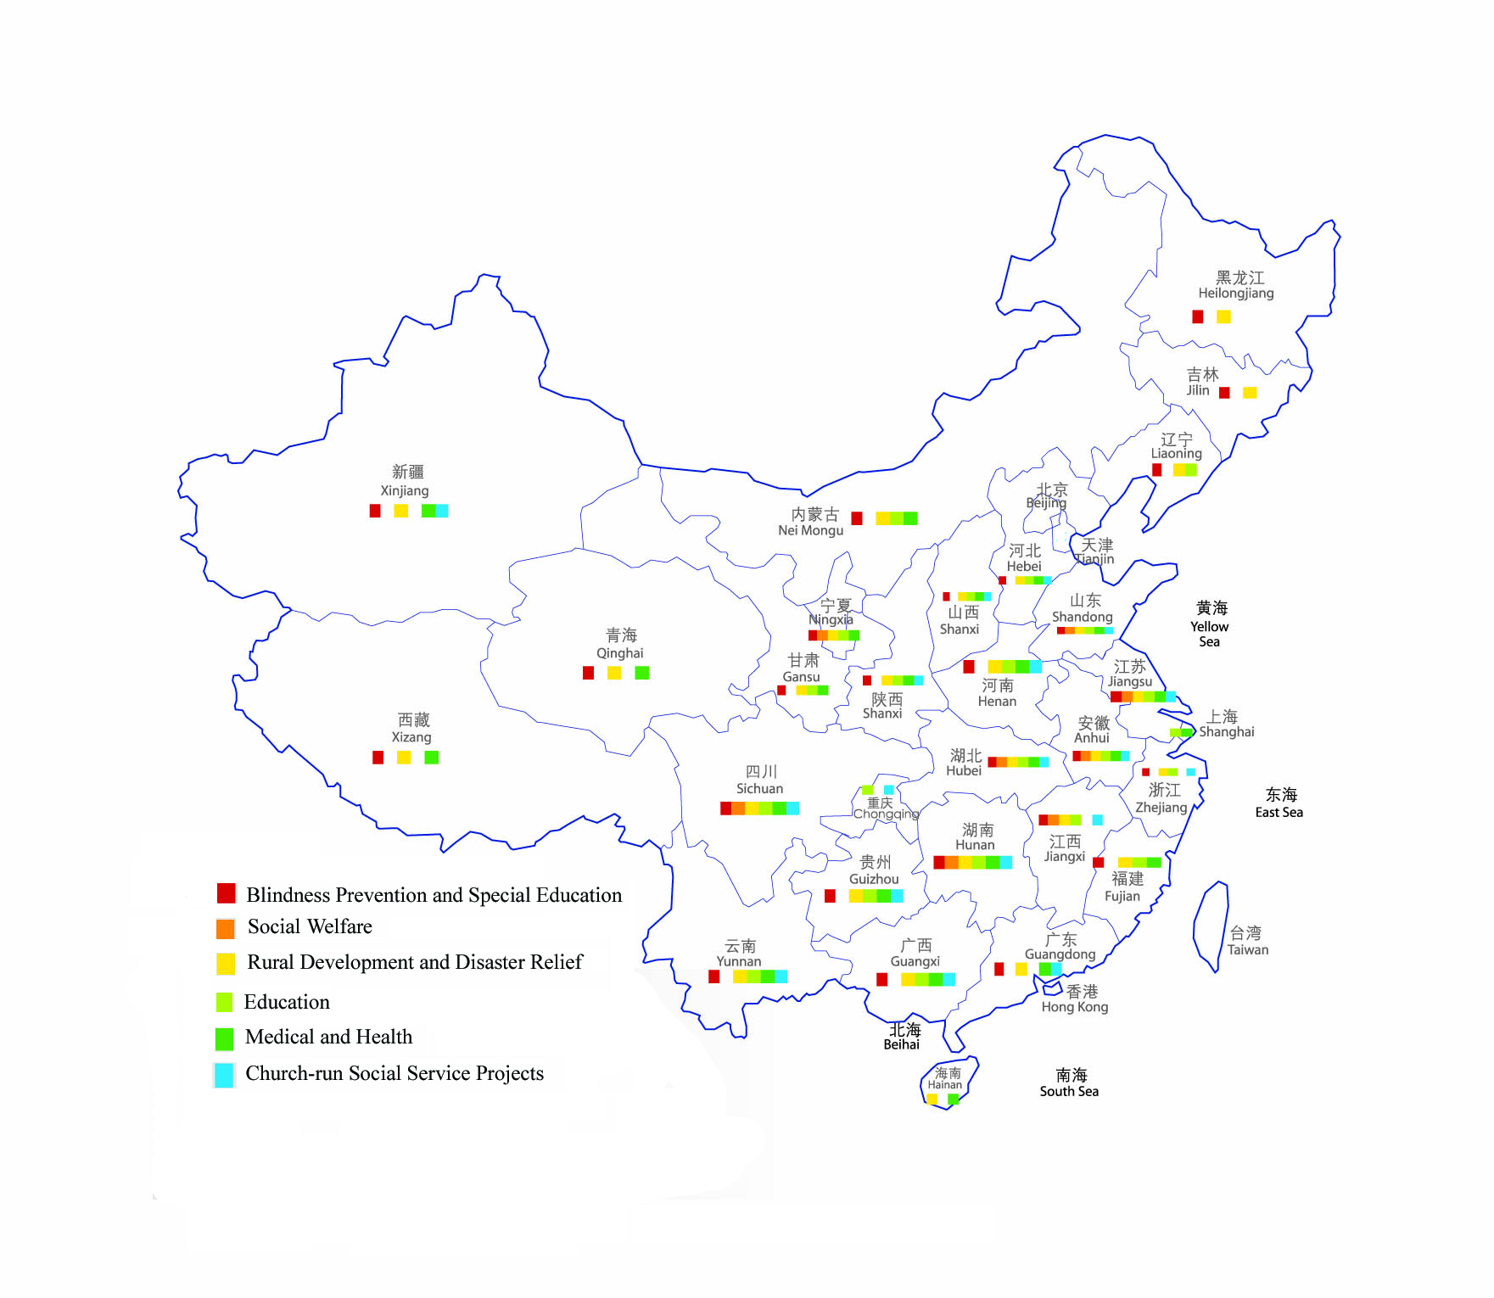
Sichuan
Yi Ethnic Community Development Project in Xide County
Integrated Rural Development Program for Yi Community, Butuo County
Community-based rehabilitation
Blindness prevention
Inner Mongolia
Environment Protection and Community Development
Snowstorm relief
Ningxia
Land management and community integrated development in Yanchi
Village doctor training
Blindness prevention
Gansu
Gansu Ecological Poverty Reduction Project
Iodine deficiency disease prevention program in Gansu
Amity Teachers Program
Gynecological disease control and treatment
Village doctor training
Blindness prevention
Henan
HIV/AIDS Awareness and Family Care Training Program
Rural Orphan Fostering
Qinghai
Solar and Biogas Program
Environment Protection and Community Development
Shandong
Rural orphan fostering
Jiangsu
Amity Teachers Program
Flood relief in 1998
Foster Care and Education Sponsorship for Orphans, Grandma Plan in the orphanages
Bilingual Deaf Education
Yunnan
Church-Based Community Development Program in Wuding County
Integrated Rural Sustainable Development Program in Cangyuan County
Food Security and Improvement of Ecological Environment
Integrated Rural Sustainable Development, Honghe County
HIV/AIDS Awareness and Family Care Training Program
Earthquake relief in 1996
Hunan
Integrated Development Project in Western Hunan
Foster Care and Education Sponsorship for Orphans, Grandma Plan in the orphanages
Community-based Rehabilitation, Medical support and Micro-credit loan Projects for leprosy victims
Blindness prevention
Guangxi
Yao and Zhuang Ethnic Community Poverty Reduction
Integrated Rural Development in Lingyun
Amity Teachers Program
Libraries of Special Education Schools
Guizhou
Food Security and Improvement of Ecological Environment
Integrated Rural Development Project in Puding, Guizhou Province
Village doctor training

Slide 6
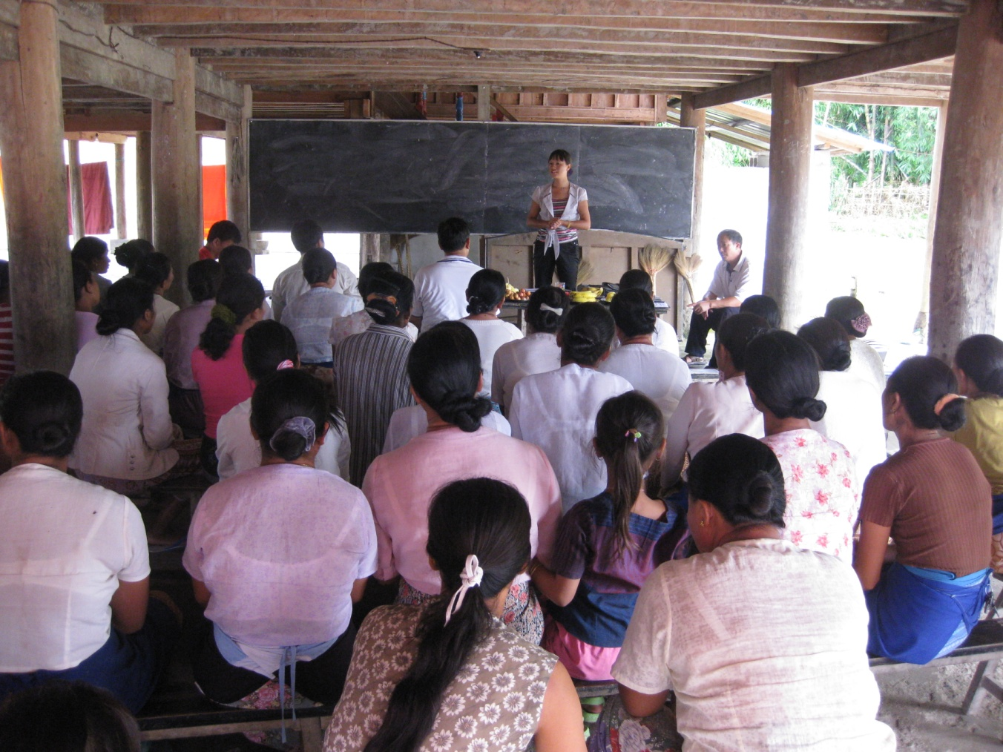
Ethnic Women’s Health Project
Located in Zhangfeng Township, Longchuan County, Yunnan Province.
Majority of women involved are of Dai ethnic minority

Slide 7
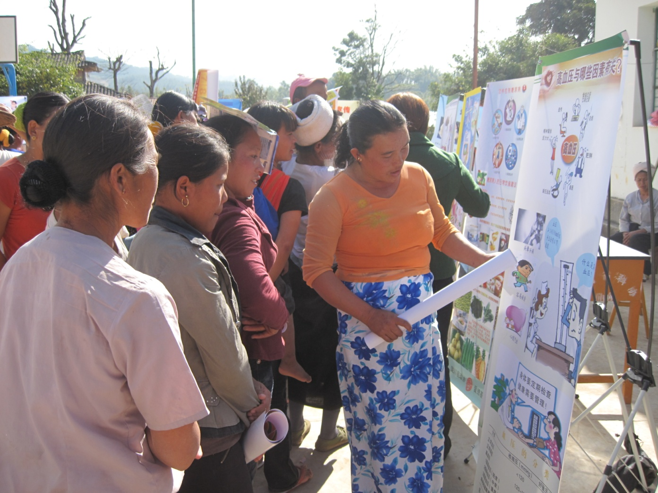
Purpose of Project
Promote local women’s awareness of health care
Change behaviour
Build up local Women’s Associations to be health advocates within their communities

Slide 8
Results
39 health workers and health volunteers trained in HIV prevention; reproductive health knowledge; diabetes/hypertension
655 village women trained in women’s reproductive health knowledge
854 village women trained in how to have a healthy pregnancy

Slide 9
500 women received physical check-ups. Of these women, 77% were shown to have some form of gynaecological problem and could take follow up action

Slide 10
Three health information bulletin boards set up in Guangshan, Nongguan and Huangxiang villages (Isabel Robinson, 15 May 2013, ©ABM)

Slide 11
300 people attended public information campaign on HIV/AIDS prevention and awareness
(Ivy Wang, April 2011, ©ABM)

Slide 12
85 sanitary toilets installed in 3 villages, with poorest households given priority (Isabel Robinson, 15 May 2013, ©ABM)

Slide 13
“Before the project, Dai people thought it was dirty to have a toilet. We all used to go in the forest. Then the sanitary toilet was introduced, but some still didn’t want the toilet because they feared the smell. But now that the toilets have been built, people want them because they are so nice and clean, and no smell at all. Some people are willing to pay for a toilet for themselves now. They’re so very clean inside, and convenient, and important for preventing disease transmission.” (Xiao Huan, a leader of the Mangbingdai Women’s Health Association, when asked how the community made decisions about who would get the toilets provided by the project.)

Slide 14
The project was driven by the Women’s Association in each village. Through the project, these associations grew in confidence and knowledge, and are able to continue health promotion work on their own (Isabel Robinson, 15 May 2013, ©ABM)

Slide 15
(Isabel Robinson, 15 May 2013 ©ABM)
Sustainability
Head of CPPCC in Longchuan County
Mr Yang
Amity Project Office in charge of project is made up CPPCC staff
Amity works with all levels of government to improve their ability to design, implement and evaluate community development work
This ensures sustainability – staff learn new and participatory ways of working with communities to meet their needs
Mr Cui
Mr Xu, Head of APO

Slide 16
Mr Yang Yusheng, Senior Bureaucrat, Poverty Alleviation Office of Yunnan CPPCC
Influencing the influencers
“Our projects in Longchuan have focussed on the development of the whole person, building up their ability to make change in their own lives. We have had an impact on every household, every single person in those villages. Over the last few years, we as government officers have learnt so much from Amity's particular approach, by putting people at the centre of the project. And now, through this project, the government has learnt how to do it. We want our government to steal and copy our ideas ten, one hundred, one thousand, one million times over all of China.”

Slide 17
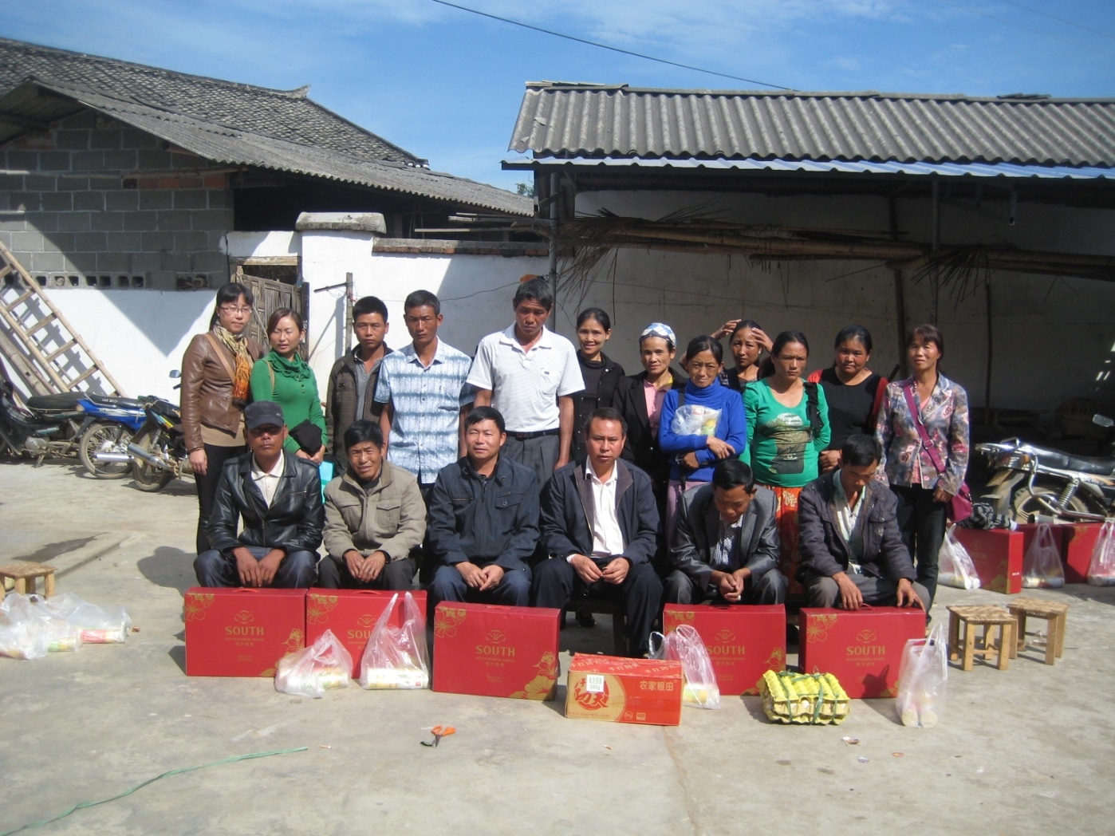
The Future
ABM will support a new 3 year project with the Amity Foundation
Location: Fengping Township, Yunnan Province (near border of Myanmar)
3391 PLHIV living in the Mangshi area
Mostly confined to injecting drug users

Slide 18
Situation
PLHIV are often unable to do manual work due to AIDS or other opportunistic infections. No stable income results.
Fear of discrimination from community leads to exclusion from society
Health workers knowledge of HIV/AIDS is low – ie 35% did not know correct means of transmission
Wider community knowledge of HIV/AIDS also low – 46% of respondents said they excluded/alienated friends or colleagues who are HIV positive

Slide 19
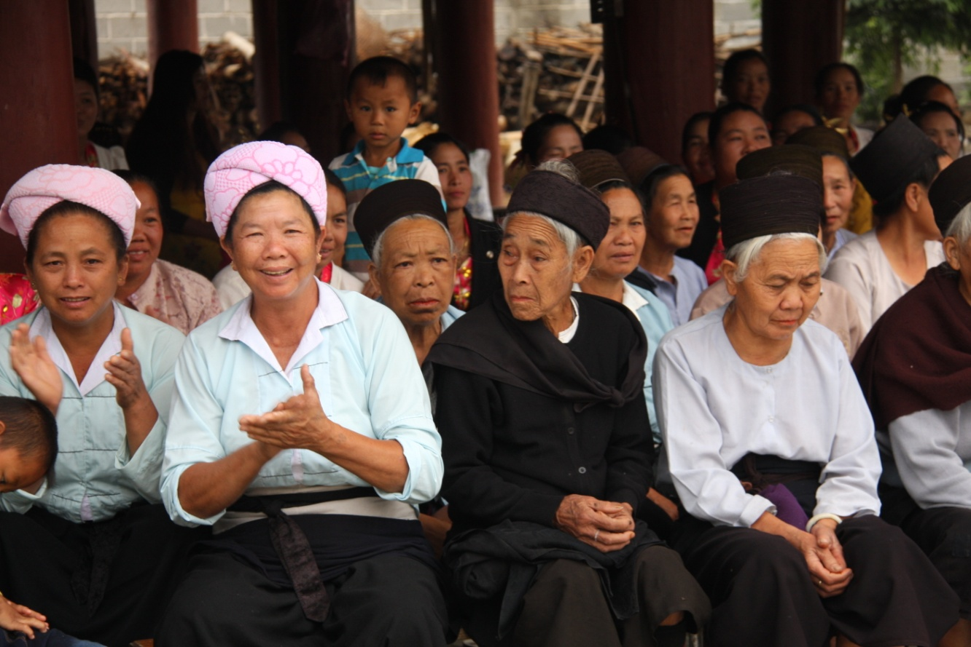
Objectives
Increase income and life quality of PLHIV through support groups, microloan scheme, agricultural training, medical assistance and social inclusion
2. Improve the quality of rural health and HIV services by training health workers and equipping health centres
3. Decreasing discrimination towards PLHIV amongst the general community through an education campaign

Slide 20
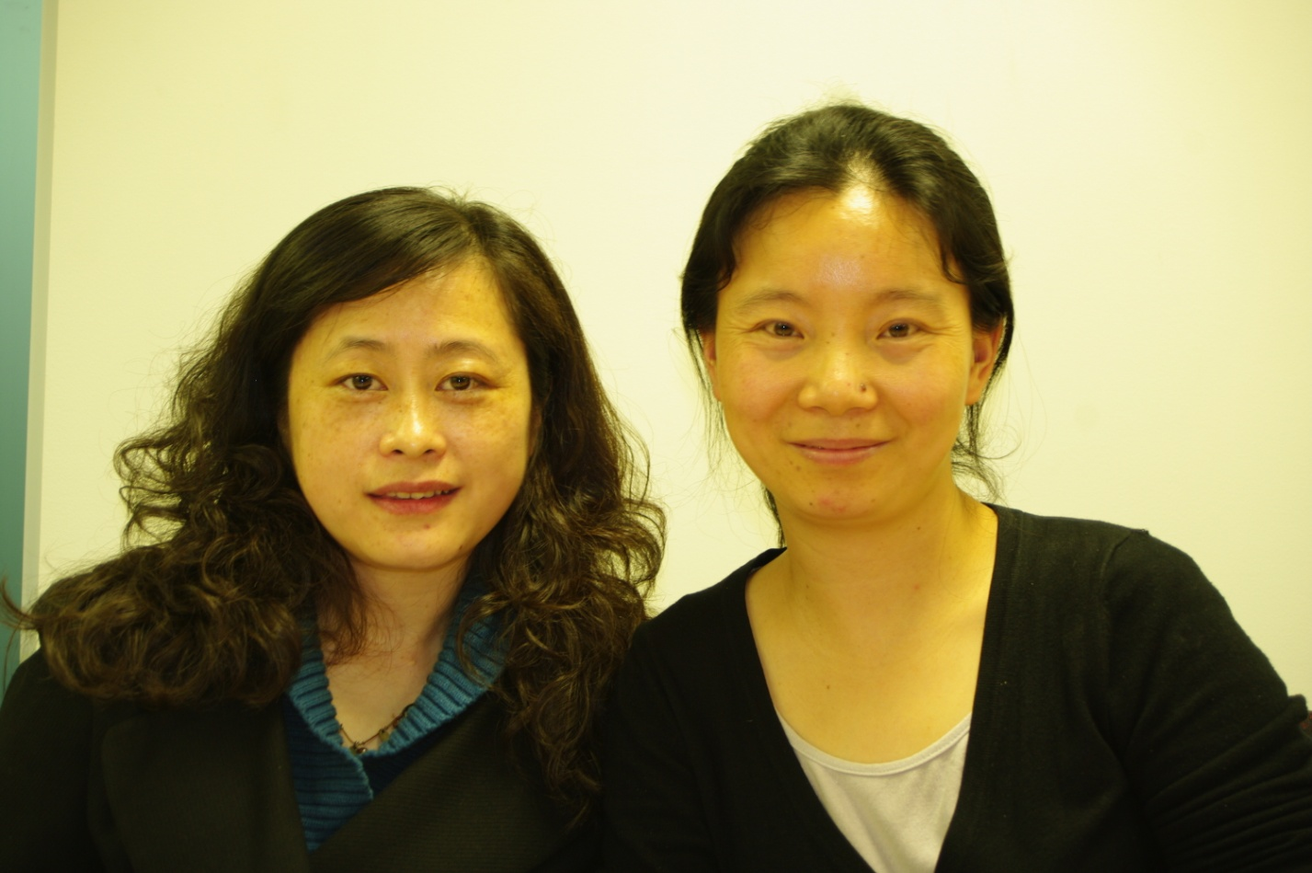
Amity Staff in Australia
In June 2013, She Hongyu and Tan Hua from Amity visited Australia
Purpose to understand the scope and strategy of ABM, deepen the friendship
To understand how civil society in Australia is structured, and how the sector engages with government
Explore possibilities for collaboration between Amity and: Anglican schools; Anglican/Uniting social service arm; ACFID

Slide 21
They met with ACFID, AusAID, Anglicare, The Albion Centre and other Australian entities. Here, our Amity friends talk with Kasy Chambers, Executive Director of Anglicare Australia. (Isabel Robinson, 15 May 2013, ©ABM)

Slide 22
‘Projects that I am responsible for are mainly based on overseas resources. For me, it’s good to know the policies and interests of different agencies. Even negative information can push us to change our old thoughts and dependence, and tell us that we have to be ready for challenge and transfer to a new life’ (Tan Hua, Public Health and HIV/AIDS Prevention Program Manager, Amity Foundation)

Slide 23
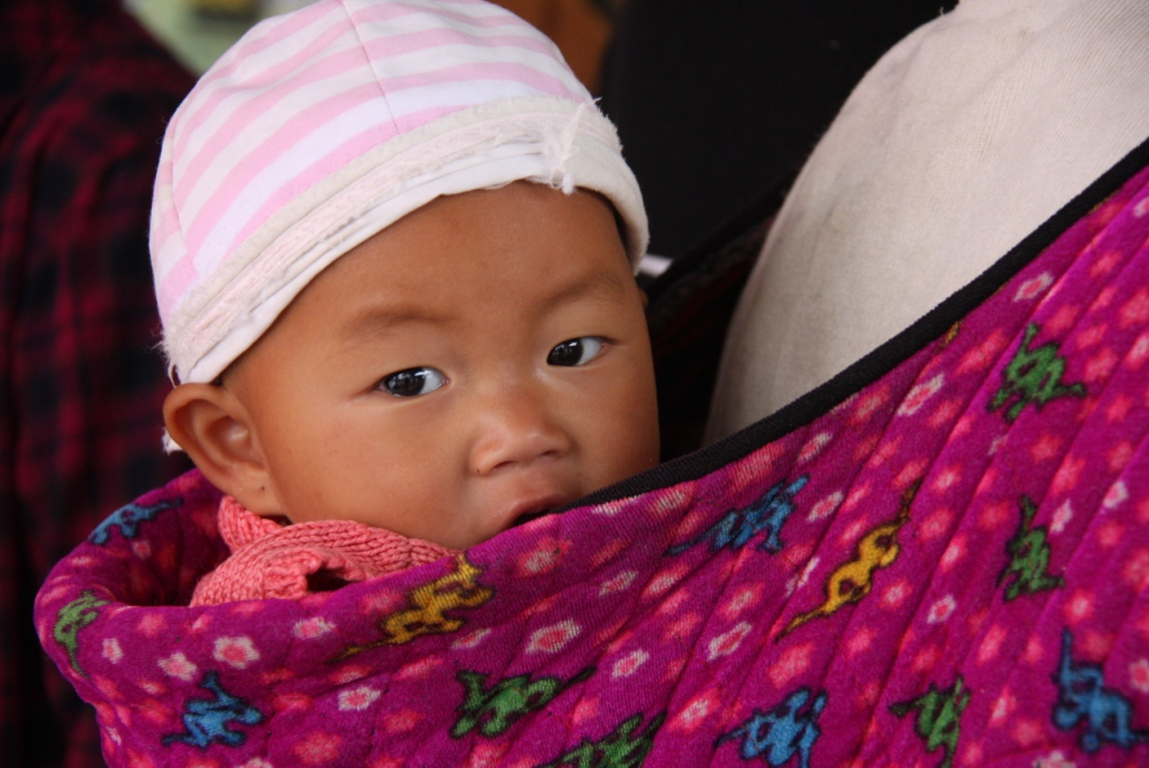
The Challenges
AusAID has ceased bilateral support to China and will not fund our ANCP China program from July 2014 onwards
Low interest in China from many ABM supporters
Despite massive economic growth in China, there are still 98.99 million rural poor (living on less than 6.3 yuan per day). Wide gap between rich and poor.
Amity still funded 40% from within China, and 60% external to China, but working to change this ratio.

Slide 24
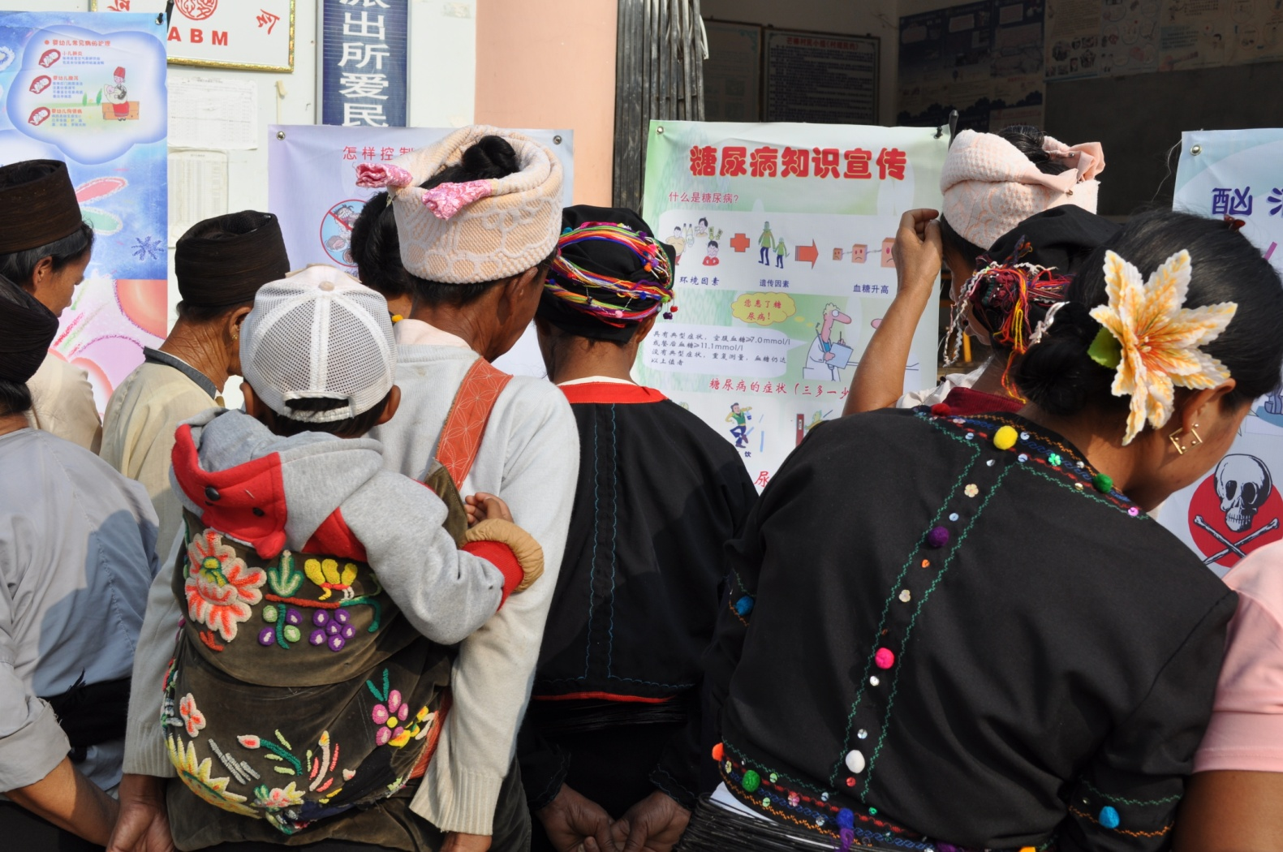
The Way Forward
ABM to support Community Based HIV/AIDS Prevention and Health Care Promotion project for full 3 years, without AusAID assistance
Opportunity for a mature partnership with two-way learning, ABM and its partners have much to learn from Amity
Not only community development projects, but people-to-people contact, organisational/sector level learning, fostering of civil society in China

Slide 25
Watch a film about Amity’s 25th anniversary:
http://www.amityfoundation.org/eng/

Slide 26
Thank you

