Slide 1
Diocesan Representatives Conference
Perth 2014

Slide 2
Conference Outcomes
What do you want to take back to your diocese next week?

Slide 3
Anglican Board of Mission
Communications Department Update
The past and the present

Slide 4
Communications Update The past and the present
We will look at the team – Who’s who?
Tour of the new ABM Website
Marketing & Fundraising focus
What the future holds…Our vision

Slide 5
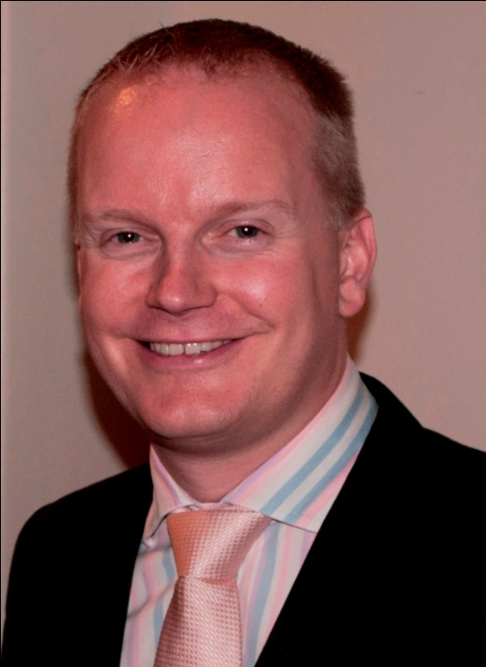
Christopher Brooks
Acting Communications & Fundraising Manager

Slide 6
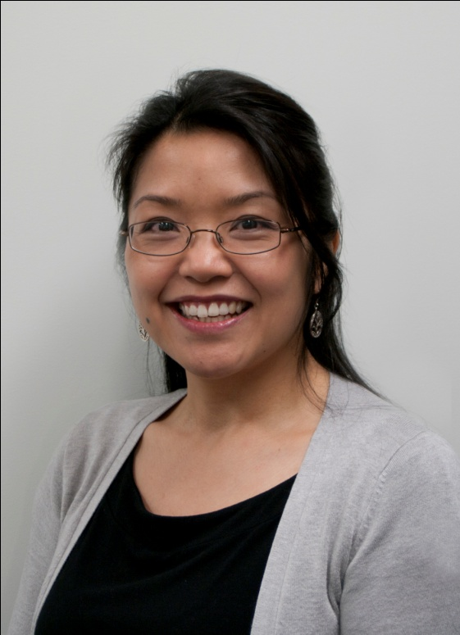
Vivienne For
Communications Coordinator

Slide 7
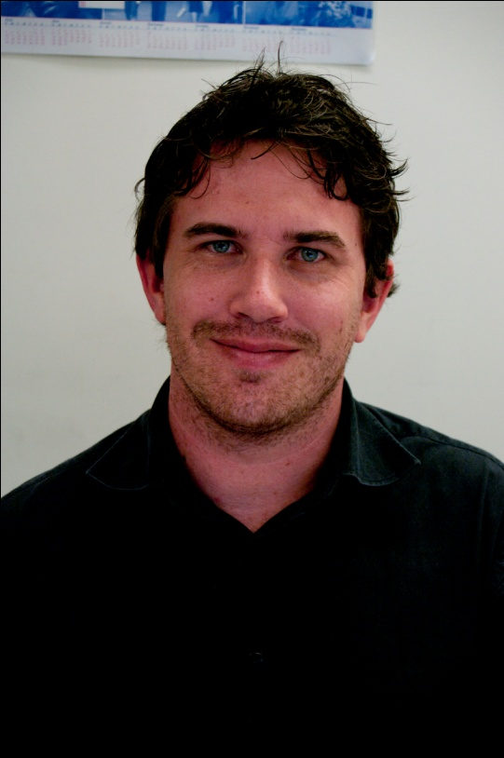
Michael Begaud
Appeals & Bequests Officer

Slide 8
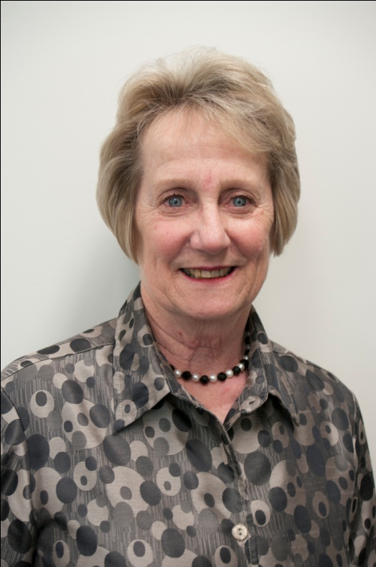
Lorraine Forster
ABM Committee Support Officer

Slide 9
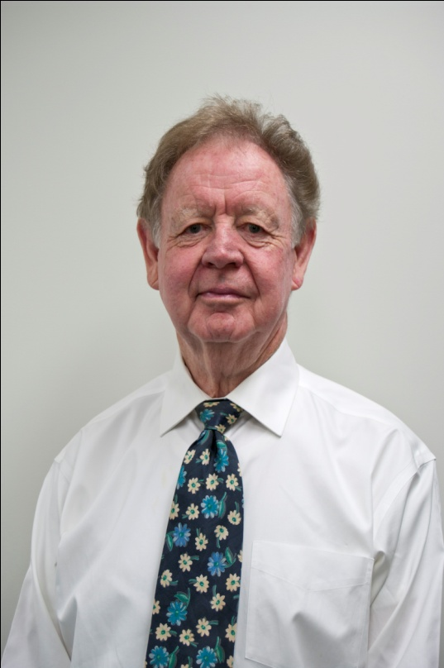
Michael Robinson
Speakers’ Organiser

Slide 10
Highlights of 2013

Slide 11
The New ABM Website & other online resources

Slide 12
Really living up to our commitment as the National Mission Agency
Better support to committees

Slide 13
Highlights continued…
Income level with 2012
Increase in numbers gifting ABM in their will
More communication about projects
Quicker response launching emergency appeals

Slide 14
Streamlined electronic communications (on-A-Mission now monthly; Pew Reflections sent 1 month earlier; Facebook page getting good traction; Twitter feed up and running; ACO reporting our news around the Communion)

Slide 15
Better Promotional awareness of ABM through targeted marketing strategies
ie: Newly designed promotional materials

Slide 16
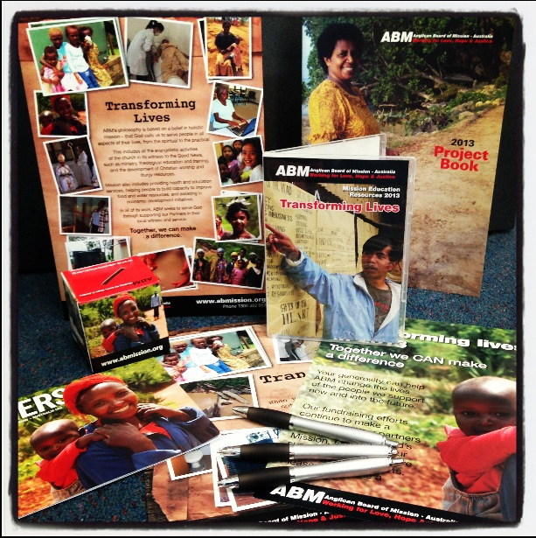

Slide 17
More time dedicated to Diocesan Representatives and Committees
Less complaints
New School’s Appeal
Increase in On-line donations

Slide 18
Challenges of 2013

Slide 19
Obtaining visas for visitors
New Christmas Appeal
Project information gathering and updates

Slide 20
The Future

Slide 21
New website
New bequest program
Better strategic Partner visits
More speaking engagements fulfilled – targeting new supporter base
More support for Parish Mission secretaries to do their work

Slide 22
Strengthening committees to carry out their work
New imagery database (meta-tagging)
Stronger volunteer presence with appropriate skill base

Slide 23
Considerations
Diocesan Reps photograph and contact details on the website
Content on Diocesan Reps page
ABM Branding, logos and letterheads
Stamps – recruit another philately expert
Banners and procedures
Audit – bank accounts, registered names

Slide 24
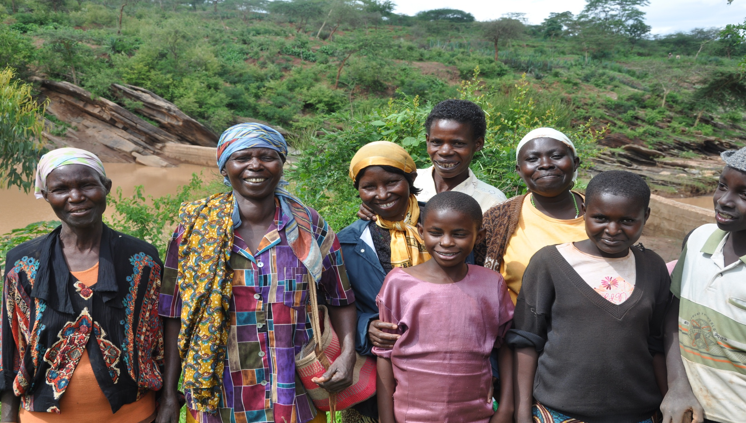
Thank you.

Slide 25
Together we can make a difference.

