Slide 1
ABM Diocesan Representatives Conference Perth 2014
Reconciliation Coordinator’s Presentation
Mal MacCallum

Slide 2
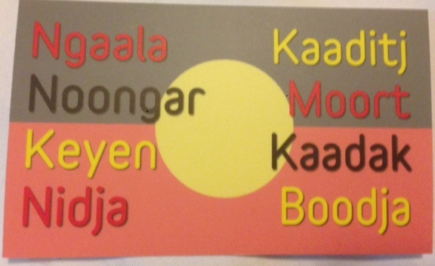

Slide 7
Who was Yagan?
“The death of Yagan on 11 July 1833 marked the end of an era in colonial-Aboriginal relations in Western Australia, and the beginning of a century-long holocaust for the Aboriginal population of WA and other Australian states.
Yagan
mid-30s when the colony was founded in June 1829, stood out amongst the community.
described by the Scottish settler as the ‘Wallace’ of his people,
did best to lead cordial relations with the British but
conflict required a legal Nyoongar response, resulted in a spiral of violence and death as both sides accused each other of atrocities.

Slide 8
deaths of brother and uncle led to reprisal killings under Nyoongar law, leading the government of the day to place a price of 30 pounds on Yagan’s head, dead or alive.
two months before he was shot (settler William Keats), Yagan had stated to another settler, George Moore, that he would kill three settlers in revenge for the death of his father Midgegooroo executed by firing squad earlier that year.
Despite the reward on his head, Yagan went about his business unmolested by most of the settlers because they feared reprisals.
After shot Yagan, was beheaded, eventually head taken England for research.
When killed, Perth living with fear Aboriginal uprising
catalyst for the attack large group of Nyoongars at Pinjarra in 1834. Pinjarra massacre
1994 Aboriginal elder Ken Colbung discovered head in a cemetery in Liverpool, England.
On 10 July 2010 Yagan’s skull was laid to rest in the Swan Valley
Read more: http://www.creativespirits.info/australia/western-australia/perth/perths-aboriginal-history#toc2#ixzz3BkamsqeW
Read more: http://www.creativespirits.info/australia/western-australia/perth/perths-aboriginal-history#toc2#ixzz3BkVmQfb8

Slide 9
All Saints, Henley Brook
in Parish of Swan
Sitting on land with a largely untold story about the First Peoples whose land it is on.

Slide 11
Current Focus

Slide 12
Key Challenges and Responsibilities
Implement ABM’s Reconciliation Action Plan
Manage all aspects of ABM’s Aboriginal and Torres Strait Islander Program
Reinvigorate ABM’s relationships with NATSIAC and other key Aboriginal and Torres Strait Islander stakeholders
Explore opportunities for raising awareness of Community Development models and partnerships with key Aboriginal and Torres Strait Islander stakeholders
Expand opportunities for engagement and cooperation between ABM and Aboriginal and Torres Strait Islander communities.

Slide 13
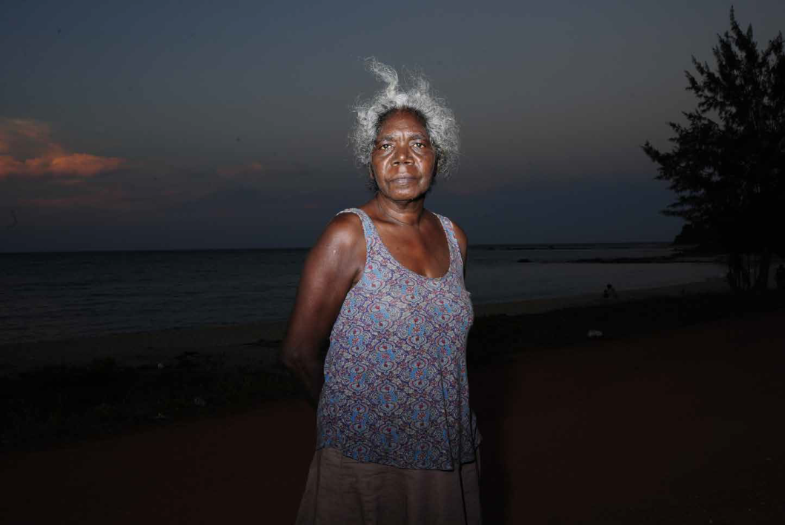
The Elders’ Report
into
Preventing Indigenous Self-harm & Youth Suicide
Foreword by Mick Gooda
Introduction by Professor Pat Dudgeon

Slide 14
Constitutional Recognition, Sovereignty, Treaty, Independence
http://www.recognise.org.au/

Slide 15
Province of Queensland Archbishop’s November Appeal
a video
https://vimeo.com/102896076
There will be a second more general video for the National Church toward supporting the Reconciliation Program

Slide 16
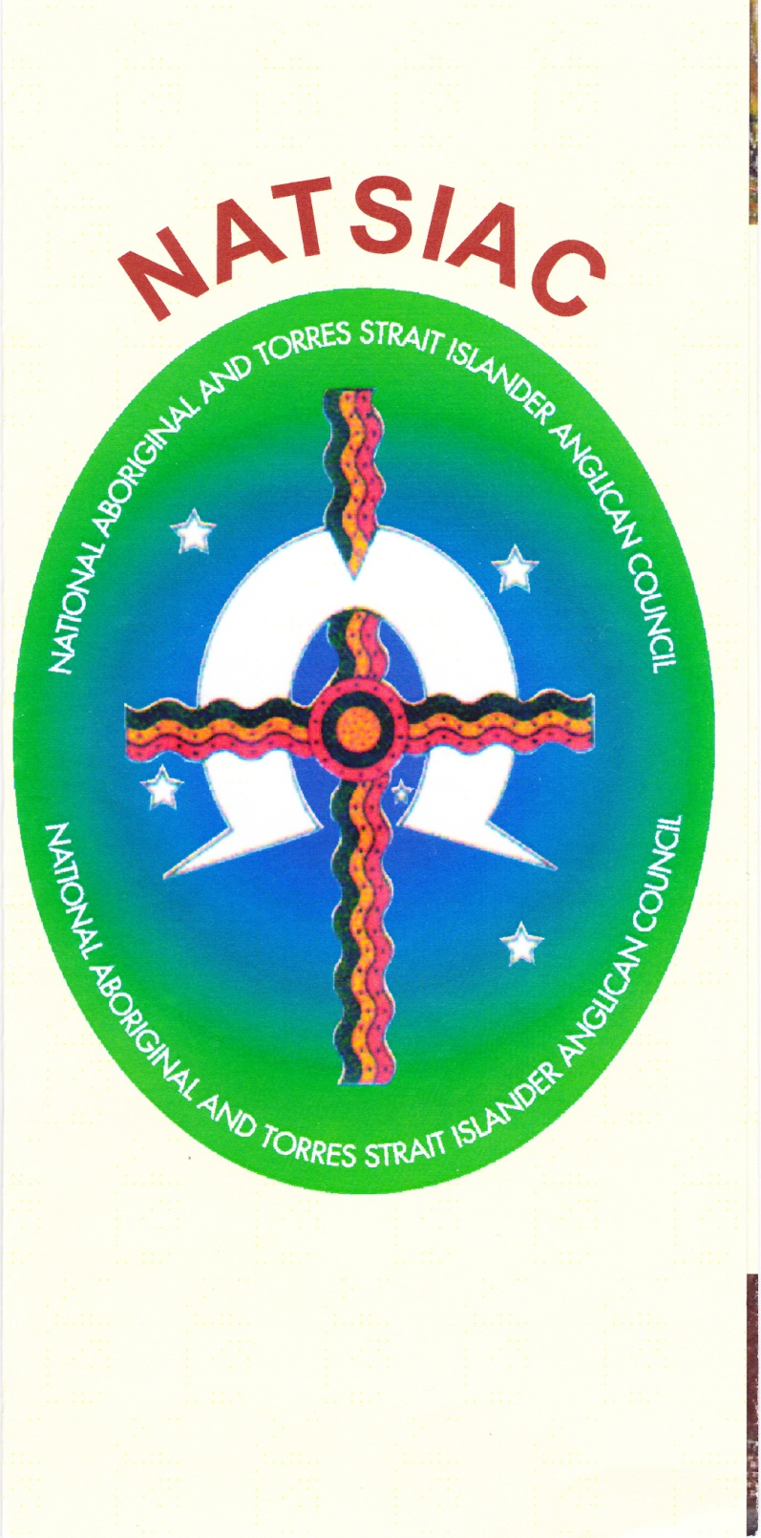
NATSIAC
NATIONAL ABORIGINAL & TORRES STRAIT ISLANDER ANGLICAN COUNCIL
2014 NATIONAL GATHERING
YAMBA NSW
3 -10 SEPTEMBER

Slide 17
What else can I do?
How can I be of help to your Diocese in the journey toward Reconciliation with your Aboriginal and Torres Strait islanders communities.
Ab. Roger Herft 28.8.14
“We are not Australian without Aboriginality”
How is the Aboriginality in your neck of this vast land?

Slide 19
Prayer for Reconciliation
Reconciliation Prayer (Bishop Arthur Malcolm) Lord God, bring us together as one, reconciled with you and reconciled with each other. You made us in your likeness, you gave us your Son Jesus Christ. He has given us forgiveness from sin. Lord God, bring us together as one, different in culture, but given new life in Jesus Christ, together as your body, your Church, your people. Lord God, bring us together as one, reconciled, healed, forgiven, sharing you with others as you have called us to do. In Jesus Christ, let us be together as one. Amen

Slide 20
Q and A: Rosalie Kunoth-Monks: "I am not the problem" speech for John Pilger's 'Utopia'
https://www.youtube.com/watch?v=Xto5mqxfDAw
Start at 3’50”

