Slide 1
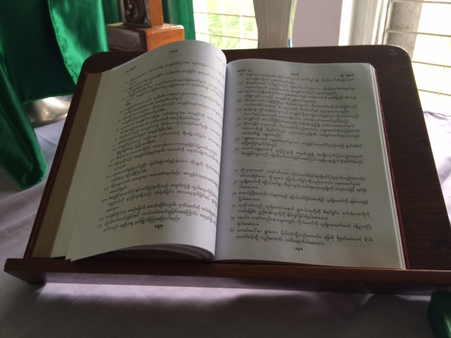
CHURCH TO CHURCH PROGRAM
Burmese Bible
2014/2015

Slide 2
What is the Church to Church (CtC) Program?
“The Church to Church Program is focussed on improving our partner’s ability to train lay people and ordinands and also to run training sessions and seminars for trained clergy, including deacons and archdeacons etc. so that they can reach out to their communities to proclaim the Good News while focussing on the five marks of mission.”
Church to Church supports programs for Theological Training and Evangelism and can actually support any worthwhile project based on the proviso that there will be no tax deductibility for any Church to Church program.

Slide 3
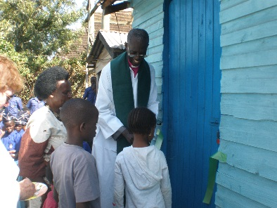
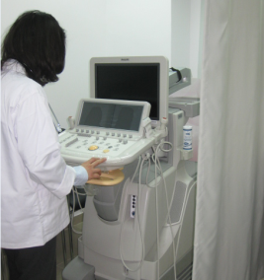
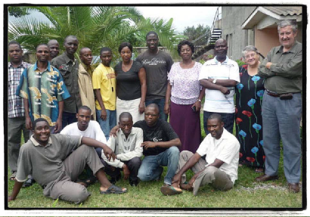
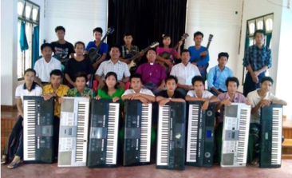
HOW DO WE ACHIEVE THESE GOALS?
Egypt
PNG
GOOD FRIDAY GIFT
Philippines
Provincial – Outreach / Evangelism
Program MBH & SSF
Aipo Rongo – Clergy Workshop Popondota – Social Media &
Communication Strategy
Popondota – Archdeacon Training &
Clergy Service
Aipo Rongo – Kerina College Theological Training for Student’s family
Episcocare
Walking Together
Developing Youth Leadership in Egypt
Summer Evangelism Conference
Evangelism & Christian Education
Kenya
Jerusalem
Improving early detection of Paediatric Diabetes & Cardiovascular Diseases.
Catechesis of the Good Shepherd
Leadership & Mgmt . Training
Zambia
Ethiopia
Myanmar
Walking Together
2015 Auxiliary Project:
Evangelism & Mission Seminars
Capacity Bldg -Training for Clergy & Sunday School Teachers
Youth Band Project
Video Editing
St John’s Seminary- Theological Training& Support
Encounter Program
Visitors come from Partner countries staying for up to 12 weeks to experience Australian & Anglican life.
Transport Project Tricycle for Sittwe Diocese

Slide 4
WHAT ARE SOME CHALLENGES WE FACE?
How to raise funds effectively for individual projects.
Difficulties with communication
  Remoteness
  Unreliable power and resources
General Attention to Detail
  Timeliness
    Receiving information by due dates
    Difficulty with calendar year projects versus ABM financial year.
    Suitable acknowledgement of Financial Funding
    Receipt of suitable acquittals before further funding sent.

Slide 5


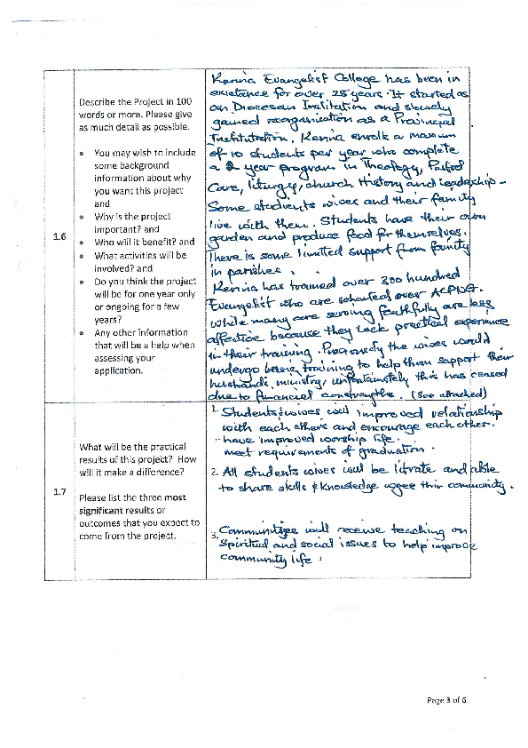
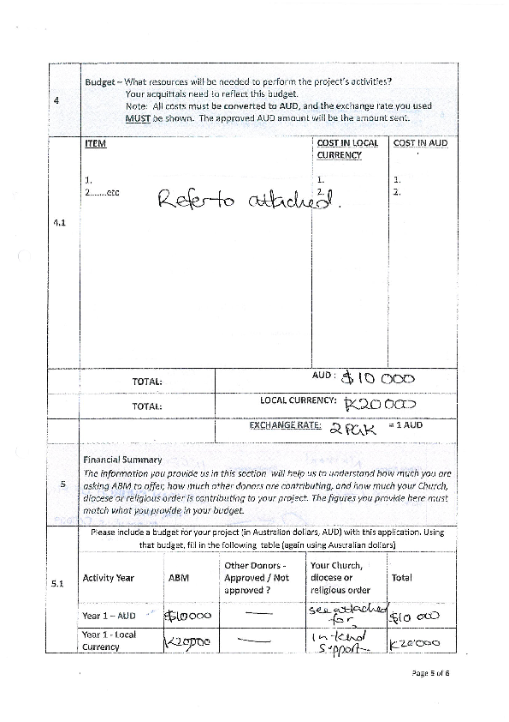
EXTRACT FROM KERINA COLLEGE APPLICATION

Slide 6
Tsendiap

Slide 7
OUTCOMES FROM THE
CHURCH TO CHURCH / PARTNER RELATIONSHIP?
Both Church to Church and our Partners are both winners!
The lives of our ABM supporters are enriched by the outcomes achieved from
their generous donations and our staff are enriched by the interaction
with our partners.
The Kenya project has been very rewarding due to our involvement with the
smooth transition for the division of Machakos into two dioceses.
Myanmar – First vehicle ever, for the Sittwe Diocese!
PNG – Ongoing training for Clergy and Lay People including
Melanesian Brotherhood, Society of St Francis and
Newton Theological College.

Slide 8
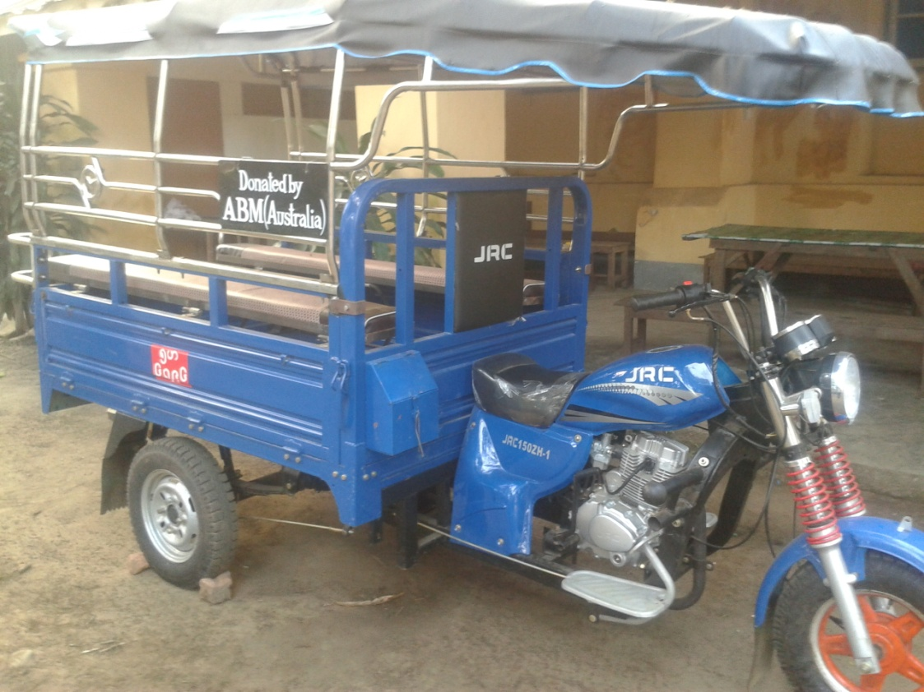
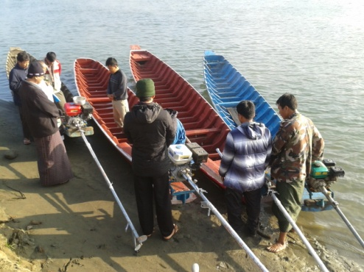
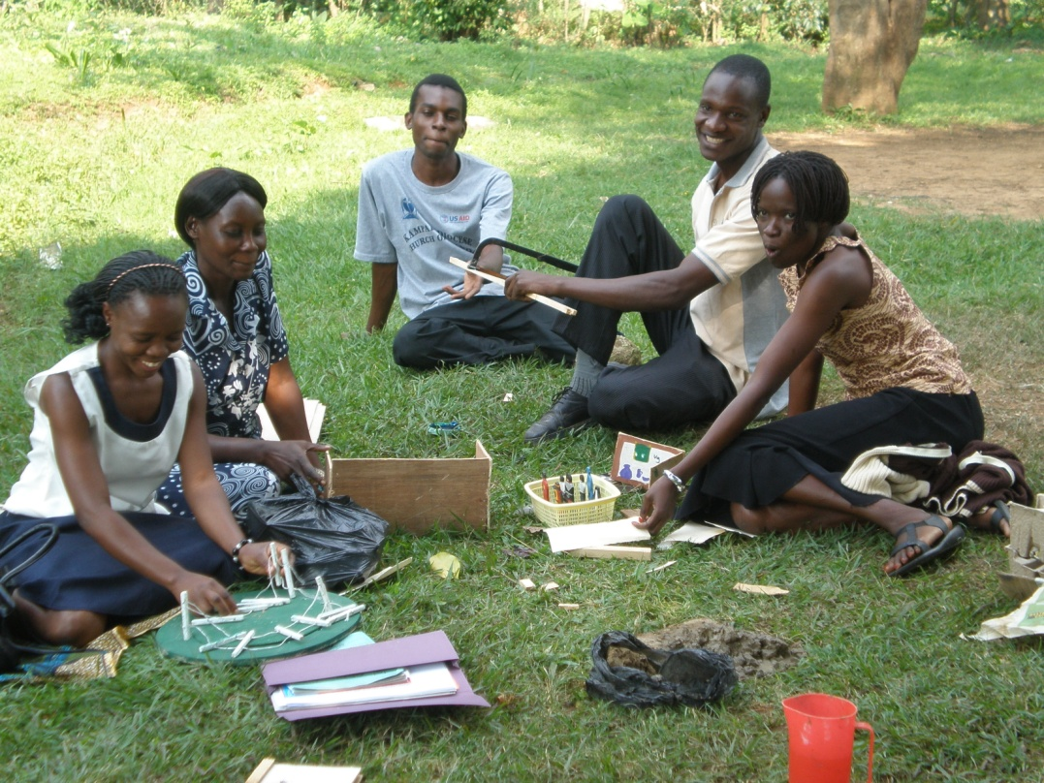
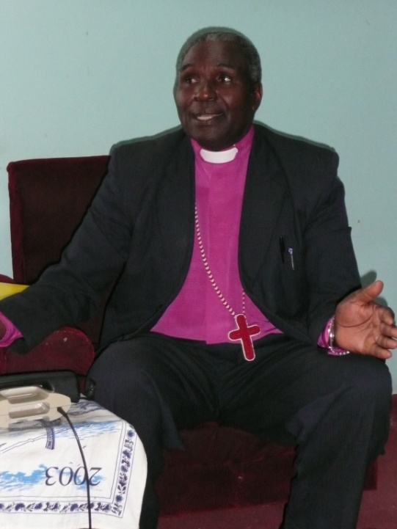
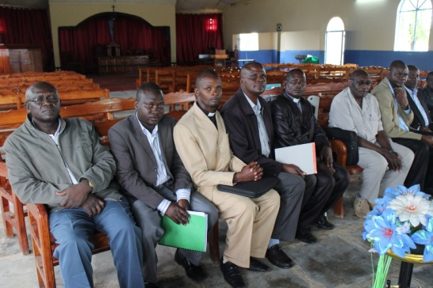
SITTWE DIOCESE BOAT ENGINES
SITTWE DIOCESE MYANMAR
FIRST MOTOR VEHICLE IN THE DIOCESE
CATECHESIS OF GOOD SHEPHERD CHILDREN’S PROGRAM LEADERSHIP TRAINING
MACHAKOS / MAKUENI LEADERSHIP GROUP

