Slide 1
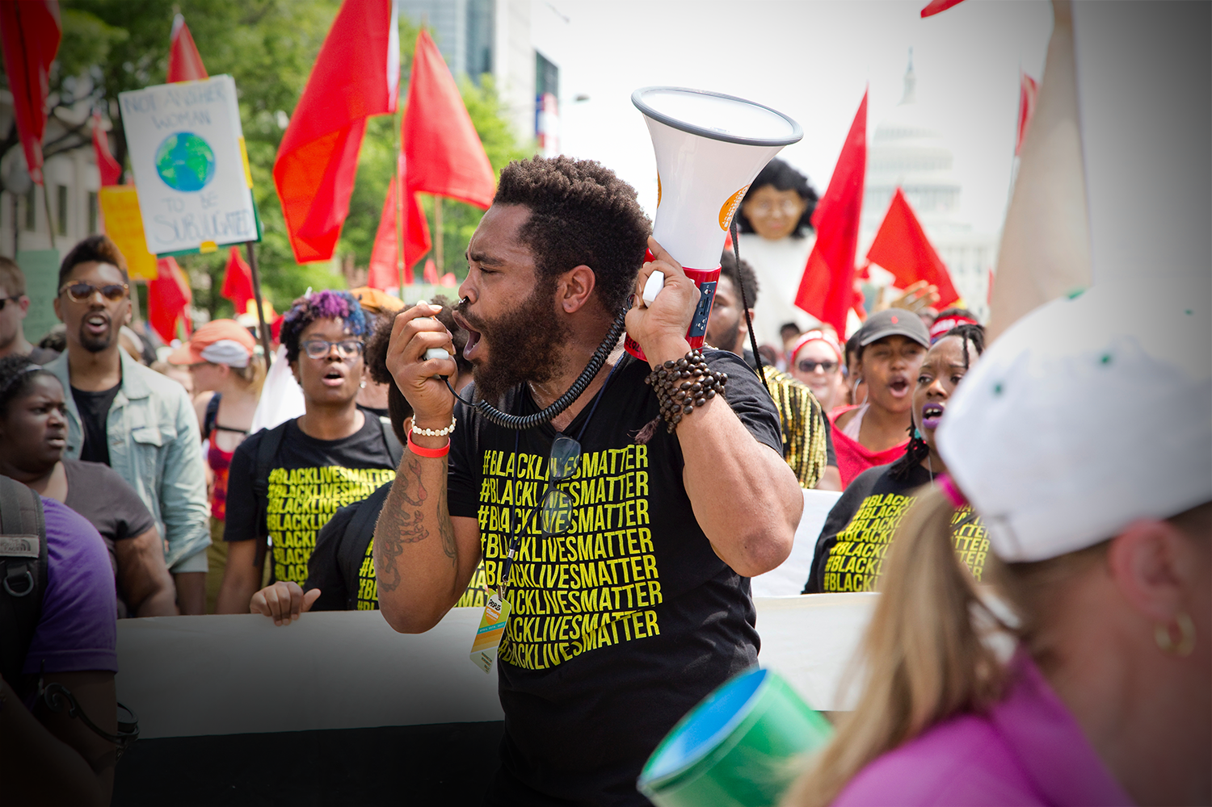
Lesson 4
Peace and Justice
Notes:
Cover photo: Free source image courtesy of Unsplash.com by Vlad Tchompalov

Slide 2
Marks of Mission
Witness to Christ’s saving, forgiving and reconciling love for all people
Build welcoming, transforming communities of faith
Stand in solidarity with the poor and needy
Challenge violence, injustice and oppression, and work for peace and reconciliation
Protect, care for and renew life on our planet

Slide 3
Introduction
What countries do you think of when you consider this particular Mark of Mission?
Why do you think of these countries?
Do you ever think of Australia as having problems with violence/injustice/oppression, or countries close to our shores?

Slide 4
Main Story
We need four readers, to play the following parts;
Narrator
Interviewer
Alan
Danny

Slide 5
Questions
What reasons did Danny and Alan give for the violence they were inflicting on their families?
Is domestic violence a problem here in Australia as well? How widespread do you think it is?
Why was a training course on Positive Parenting methods effective in changing the violent behaviour in Danny and Alan’s lives?

Slide 6
Bible reading
Matthew 5: 1-10

Slide 7
Discussion
How do you respond to this passage? What stands out the most for you?
How would you live out these beatitudes?
Is it possible for us to play a role in ending violence and oppression, and bring justice to the world?
What would this look like? What kinds of things would we need to do?

Slide 8
Prayer
Prayer of St. Francis (slightly adapted)
Lord, make us instruments of your peace.
Where there is hatred, let us sow love.
Where there is injury, pardon.
Where there is doubt, faith.
Where there is despair, hope.
Where there is darkness, light.
Where there is sadness, joy.

Slide 9
God, grant that we may not so much seek to be consoled, as to console;
To be understood, as to understand;
To be loved, as to love.
For it is in giving that we receive.
It is in pardoning that we are pardoned,
And it is in dying that we are born to Eternal Life.
Amen.

