Slide 1
Millennium Development Goals

Slide 2
At the United Nations Millennium Summit in 2000, world leaders met to develop a plan to improve the quality of life in developing countries.

Slide 3
All countries signed the Millennium Declaration, the first internationally agreed upon framework for fighting global poverty, hunger, disease, and inequality.

Slide 4
By signing the Declaration, all countries
“recognize that, in addition to our separate responsibilities to our individual societies, we have a collective responsibility to uphold the principles of human dignity, equality, and equity at the global level.”

Slide 5
By signing the Declaration, all countries
“As leaders we have a duty therefore to all of the world’s people, especially the most vulnerable and, in particular, the children of the world, to whom the future belongs.”

Slide 6
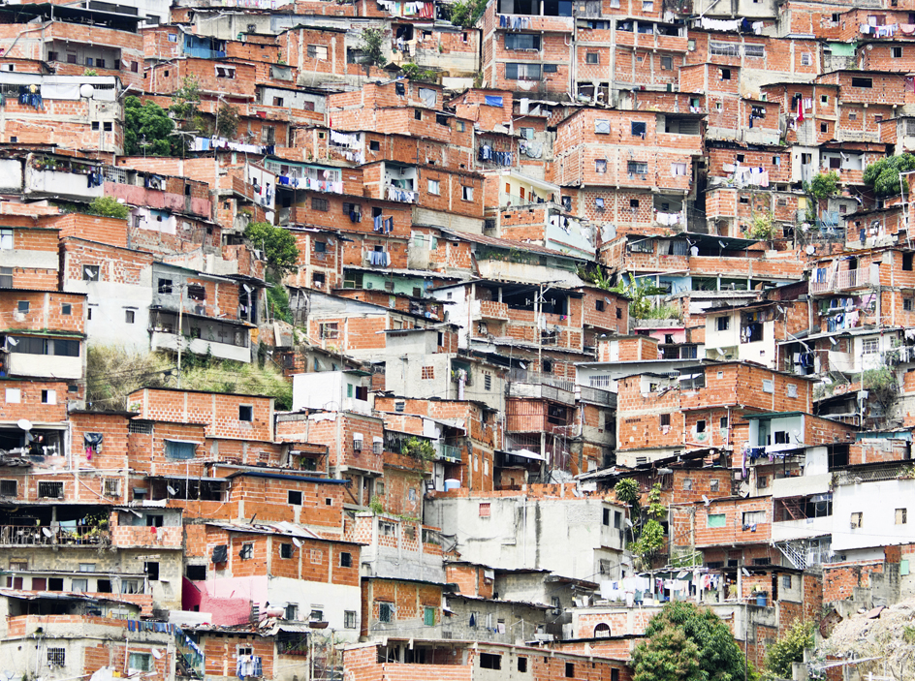
To realise the aspirations of the Millennium Declaration, eight specific development goals were created. Now known as the Millennium Development Goals (MDGs), these goals address the root causes of poverty and inequality with a target achievement date of 2015.

Slide 7
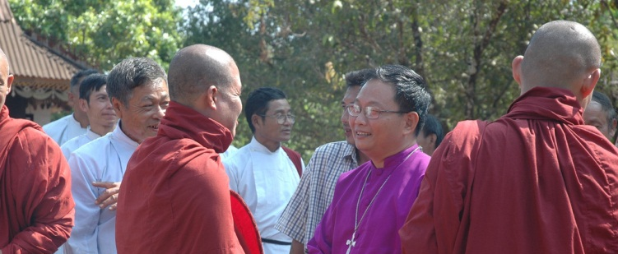
The Millennium Development Goals

Slide 8
Goal 1 Eradicate extreme poverty and hunger
Reduce by half the proportion of people living on less
than a dollar a day.
Reduce by half the proportion of people who suffer from hunger.

Slide 9
Goal 2 Achieve universal primary education
Ensure that all boys and girls complete
a full course of primary schooling.

Slide 10
Goal 3 Promote gender equality and empower women
Eliminate gender disparity in primary and secondary education preferably by 2005, and at all levels by 2015.

Slide 11
Goal 4 Reduce child mortality
Reduce by two-thirds the mortality rate
among children under five.

Slide 12
Goal 5 Improve maternal health
Reduce by three-quarters the maternal mortality ratio.

Slide 13
Goal 6 Combat HIV/AIDS, malaria, and other diseases
Halt and begin to reverse the spread of HIV/AIDS.
Halt and begin to reverse the incidence of malaria and other major diseases.

Slide 14
Goal 7 Ensure environmental sustainability
Integrate the principles of sustainable development into country policies and programs; reverse loss of environmental resources.
Reduce by half the proportion of people without sustainable access to safe drinking water and basic sanitation.

Slide 15
Goal 8 Develop a global partnership for development
Further develop an open trading and financial system that is rule-based, predictable, and non-discriminatory. This includes a commitment to good governance, development and poverty reduction—nationally and internationally.

