Slide 1
Laudato si’:
a clear and definitive ethical imperative to act
Professor Neil Ormerod

Slide 2
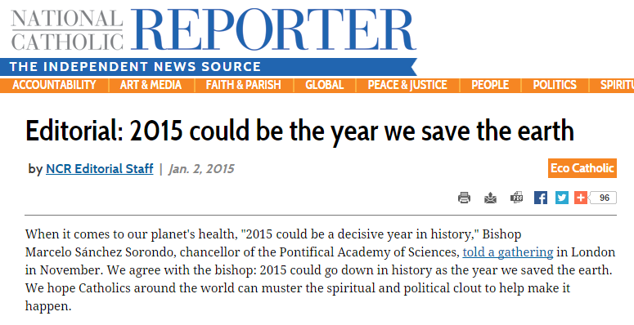

Slide 3
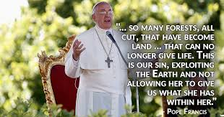
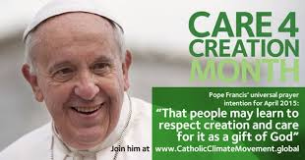

Slide 4
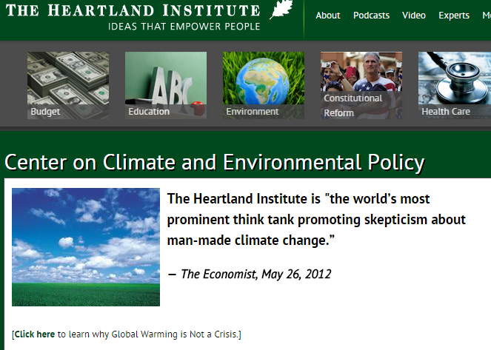
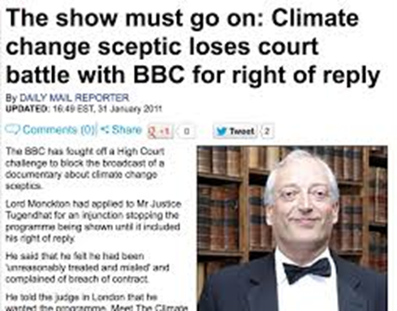
“You demean the office that you hold and you demean the church whom it is your sworn duty to protect and defend and advance.”

Slide 5
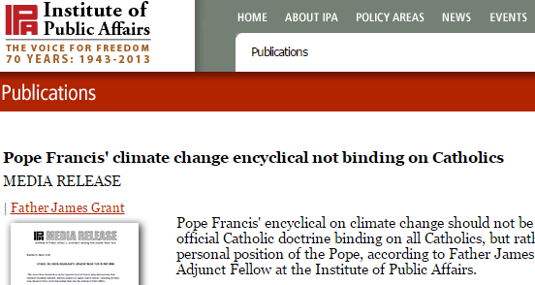
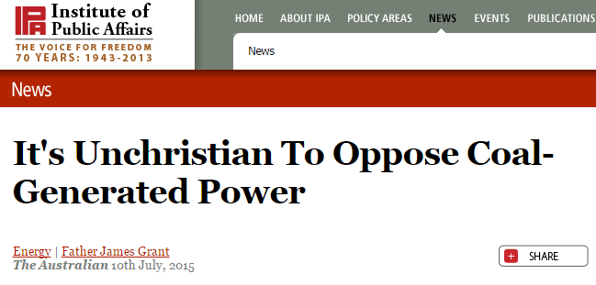

Slide 6
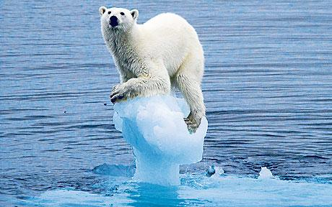
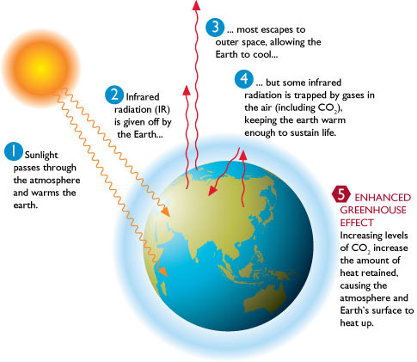
The climate is a common good, belonging to all and meant for all. At the global level, it is a complex system linked to many of the essential conditions for human life. A very solid scientific consensus indicates that we are presently witnessing a disturbing warming of the climatic system. … Humanity is called to recognize the need for changes of lifestyle, production and consumption, in order to combat this warming or at least the human causes which produce or aggravate it.

Slide 7
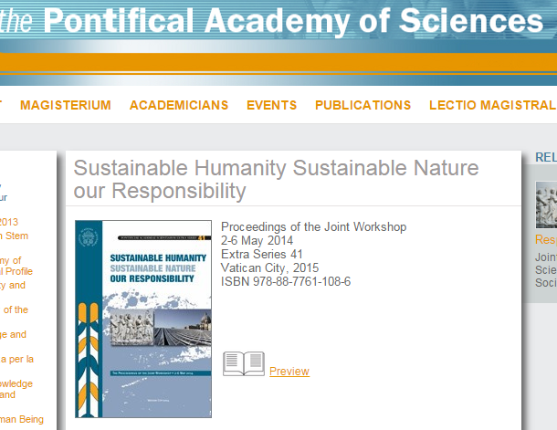
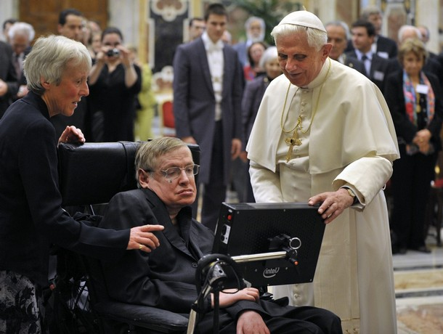
We the undersigned have assembled at the Pontifical Academies of Sciences and Social Sciences to address the challenges of human-induced climate change, extreme poverty, and social marginalization, including human trafficking, in the context of sustainable development. We join together from many faiths and walks of life, reflecting humanity’s shared yearning for peace, happiness, prosperity, justice, and environmental sustainability. We have considered the overwhelming scientific evidence regarding human-induced climate change, the loss of biodiversity, and the vulnerabilities of the poor to economic, social, and environmental shocks.

Slide 8
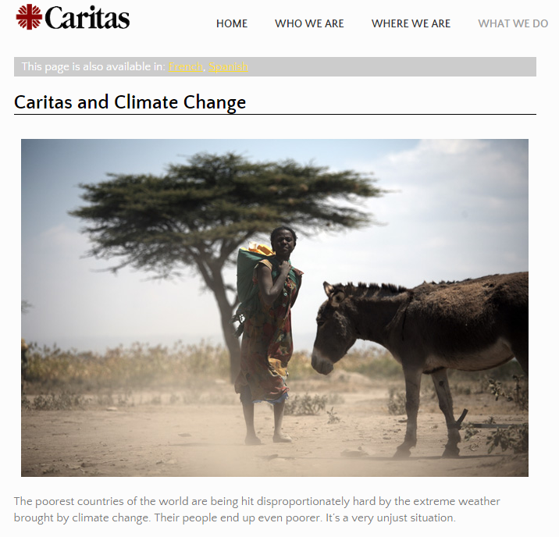
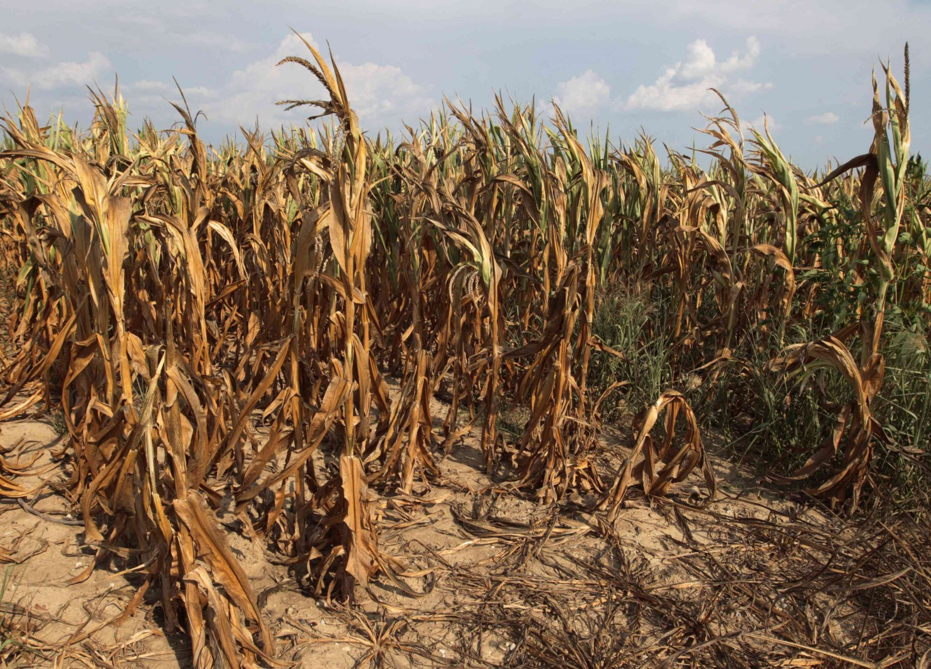

Slide 9
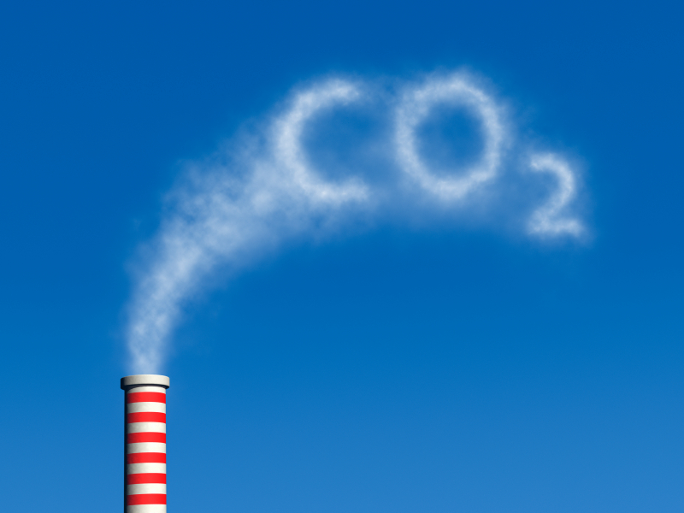
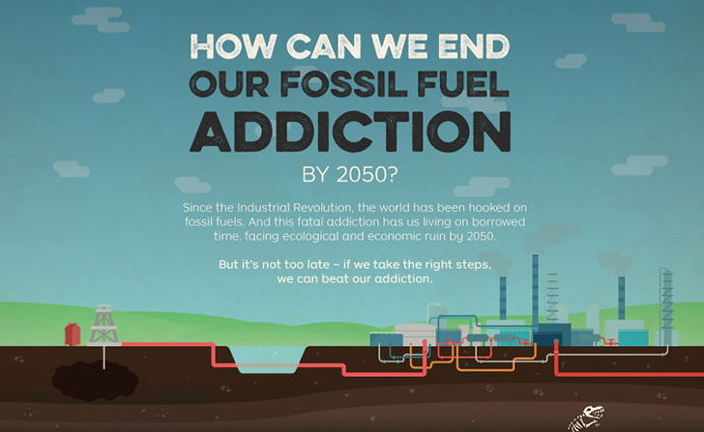
yet a number of scientific studies indicate that most global warming in recent decades is due to the great concentration of greenhouse gases (carbon dioxide, methane, nitrogen oxides and others) released mainly as a result of human activity. … The problem is aggravated by a model of development based on the intensive use of fossil fuels, which is at the heart of the worldwide energy system.

Slide 10
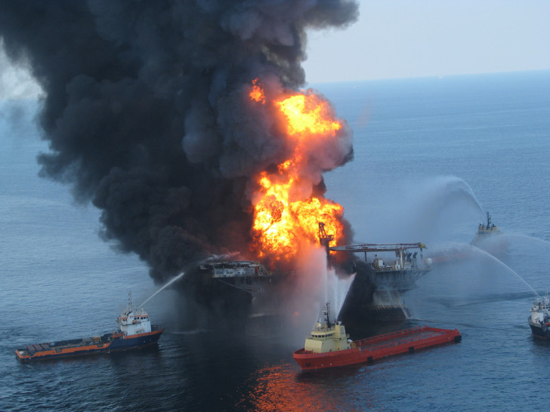
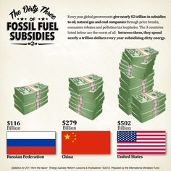
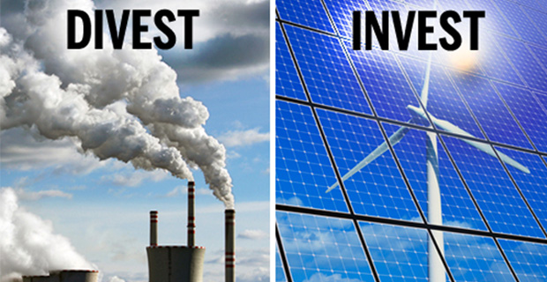
There is an urgent need to develop policies so that, in the next few years, the emission of carbon dioxide and other highly polluting gases can be drastically reduced, for example, substituting for fossil fuels and developing sources of renewable energy.

Slide 11
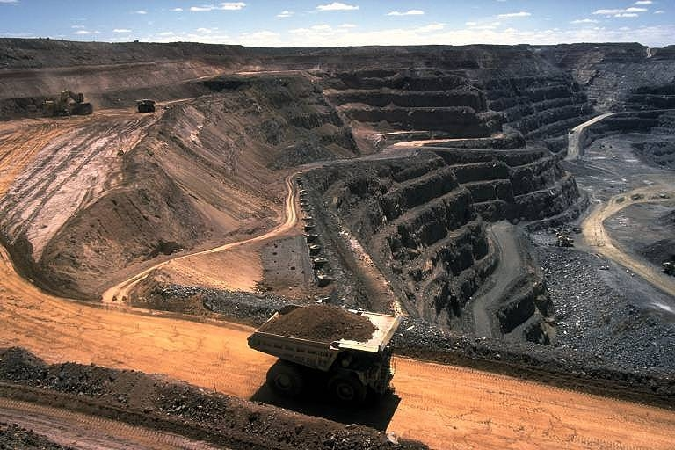
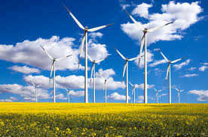
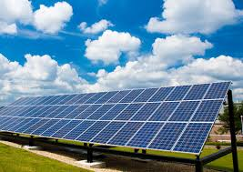
We know that technology based on the use of highly polluting fossil fuels – especially coal, but also oil and, to a lesser degree, gas – needs to be progressively replaced without delay. Until greater progress is made in developing widely accessible sources of renewable energy, it is legitimate to choose the lesser of two evils or to find short-term solutions.

Slide 12
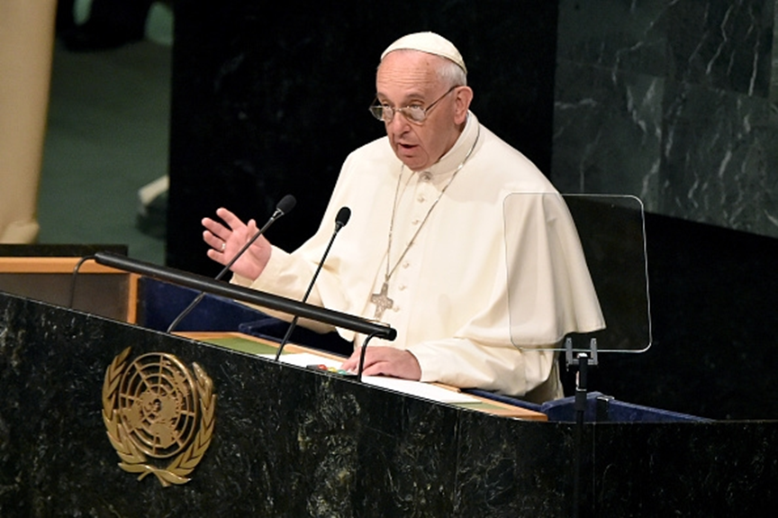
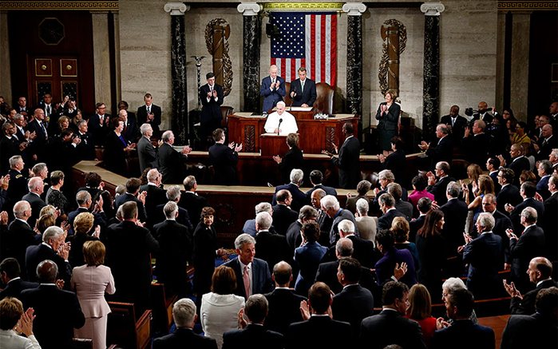
Enforceable international agreements are urgently needed, since local authorities are not always capable of effective intervention. Relations between states must be respectful of each other’s sovereignty, but must also lay down mutually agreed means of averting regional disasters which would eventually affect everyone. Global regulatory norms are needed to impose obligations and prevent unacceptable actions, for example, when powerful companies dump contaminated waste or offshore polluting industries in other countries.

Slide 13
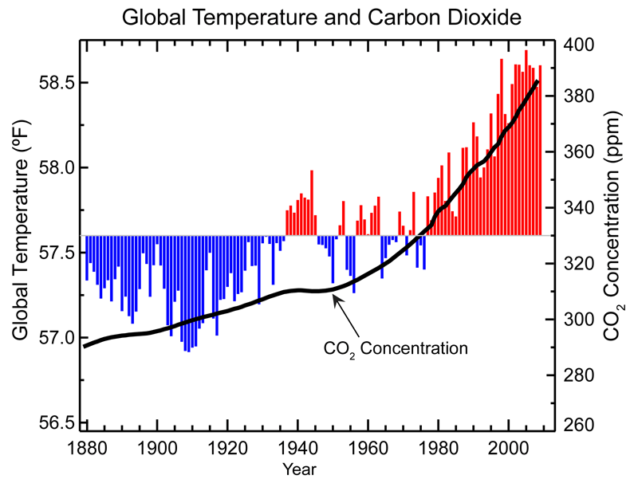
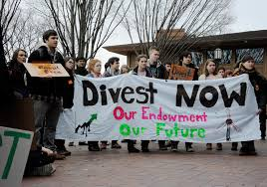
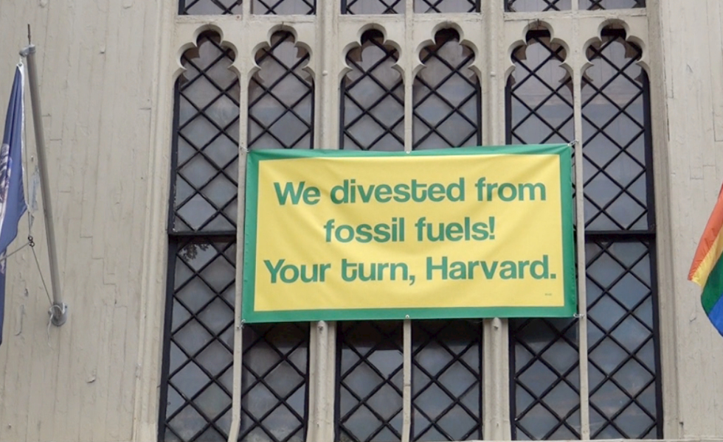

Slide 14
Religious bodies that have divested:
The Moetzah, Council of Progressive Rabbis of Australia, New Zealand and Asia
Uniting Church Synod of Victoria/Tasmania
Society of Friends (Quakers) in Australia
Uniting Church in Australia Assembly
Anglican Diocese of Perth
Anglican Diocese of Canberra-Goulburn
Uniting Church Synod of Western Australia
Presbyterian Church of Aotearoa/New Zealand
Anglican Diocese of Melbourne

Slide 15
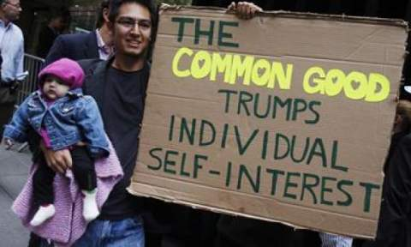
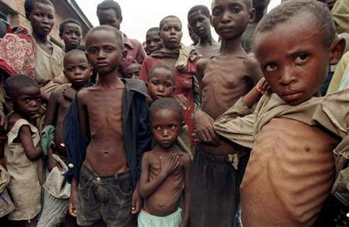
Hence every ecological approach needs to incorporate a social perspective which takes into account the fundamental rights of the poor and the underprivileged. The principle of the subordination of private property to the universal destination of goods, and thus the right of everyone to their use, is a golden rule of social conduct and “the first principle of the whole ethical and social order”

Slide 16
Climate change … represents one of the principal challenges facing humanity in our day. … Many of the poor live in areas particularly affected by phenomena related to warming, and their means of subsistence are largely dependent on natural reserves and ecosystemic services such as agriculture, fishing and forestry. They have no other financial activities or resources which can enable them to adapt to climate change or to face natural disasters, and their access to social services and protection is very limited.

Slide 17
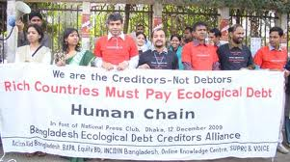
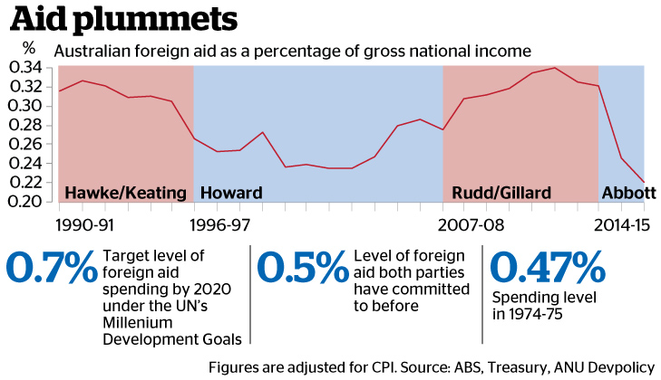
Inequity affects not only individuals but entire countries; it compels us to consider an ethics of international relations. A true “ecological debt” exists, particularly between the global north and south, connected to commercial imbalances with effects on the environment, and the disproportionate use of natural resources by certain countries over long periods of time.

Slide 18
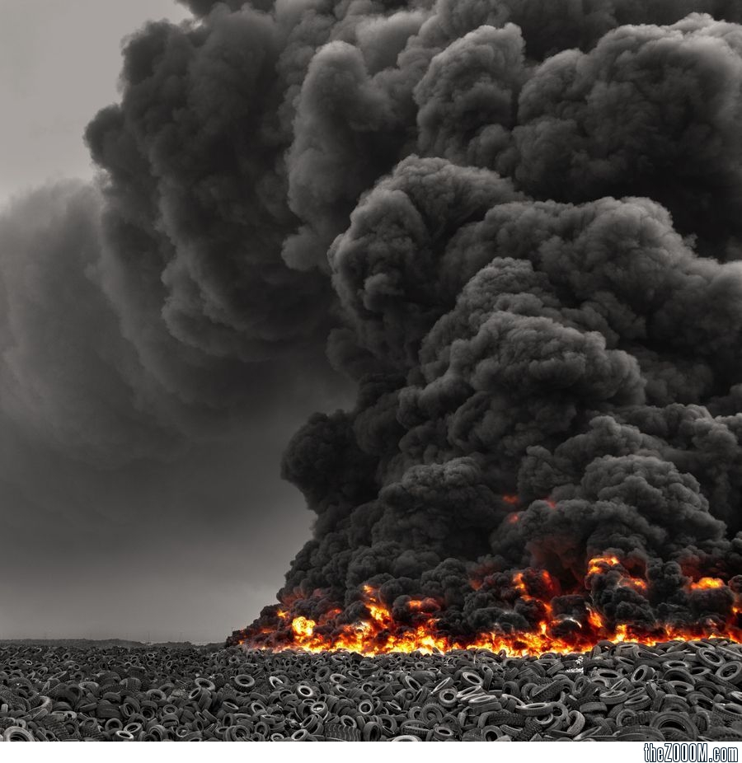
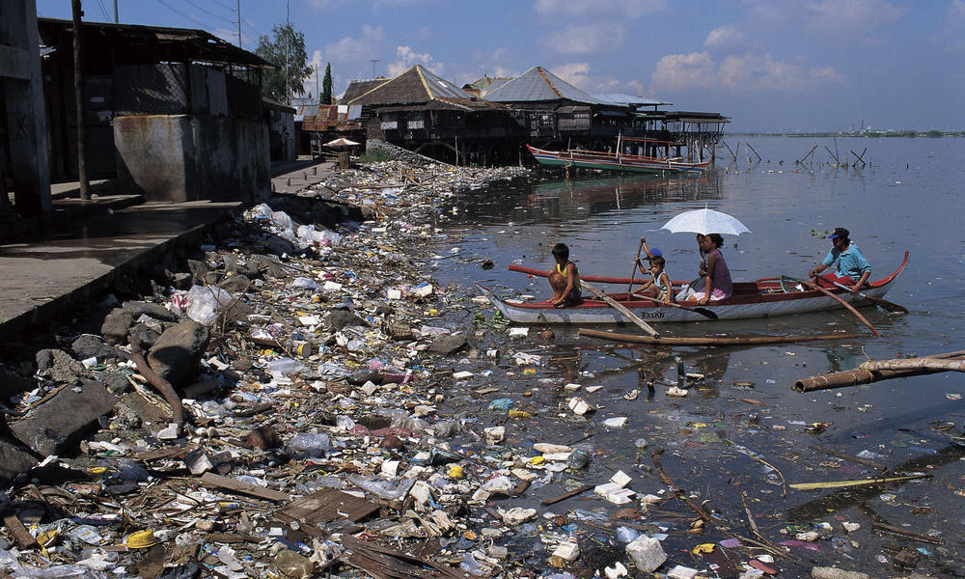
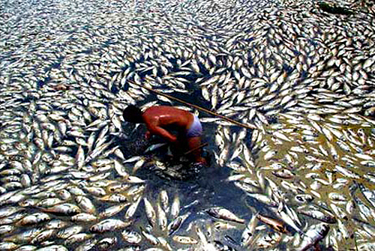
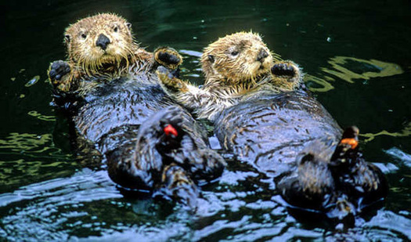
Doomsday predictions can no longer be met with irony or disdain. We may well be leaving to coming generations debris, desolation and filth. The pace of consumption, waste and environmental change has so stretched the planet’s capacity that our contemporary lifestyle, unsustainable as it is, can only precipitate catastrophes.

Slide 19
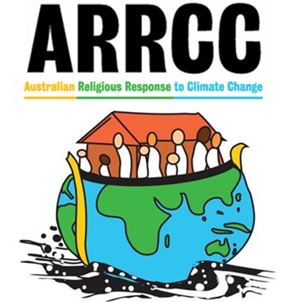
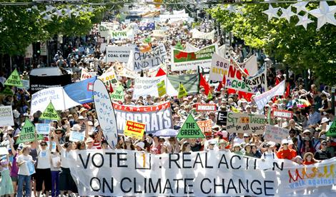
Society is also enriched by a countless array of organizations which work to promote the common good and to defend the environment, whether natural or urban. Some, for example, show concern for a public place …, and strive to protect, restore, improve or beautify it as something belonging to everyone. Around these community actions, relationships develop or are recovered and a new social fabric emerges.

Slide 20
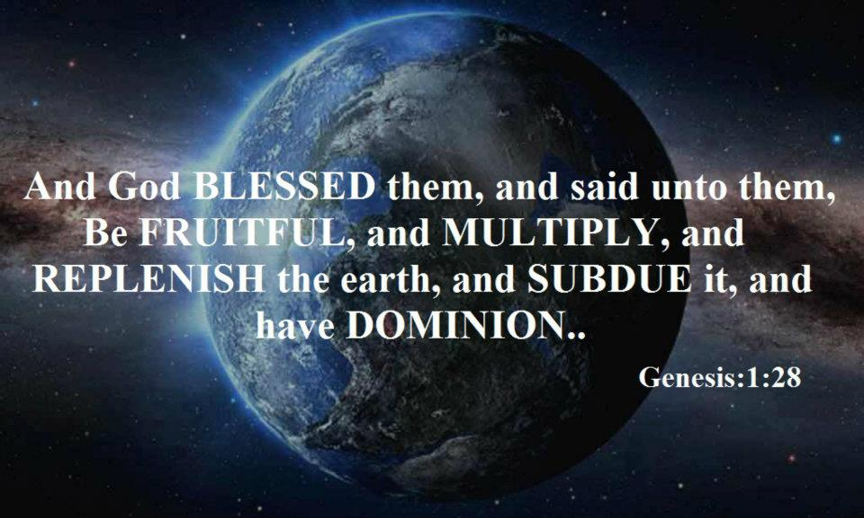
This allows us to respond to the charge that Judaeo-Christian thinking, on the basis of the Genesis account which grants man “dominion” over the earth (cf. Gen 1:28), has encouraged the unbridled exploitation of nature by painting him as domineering and destructive by nature. This is not a correct interpretation of the Bible as understood by the Church.

